Slide 1
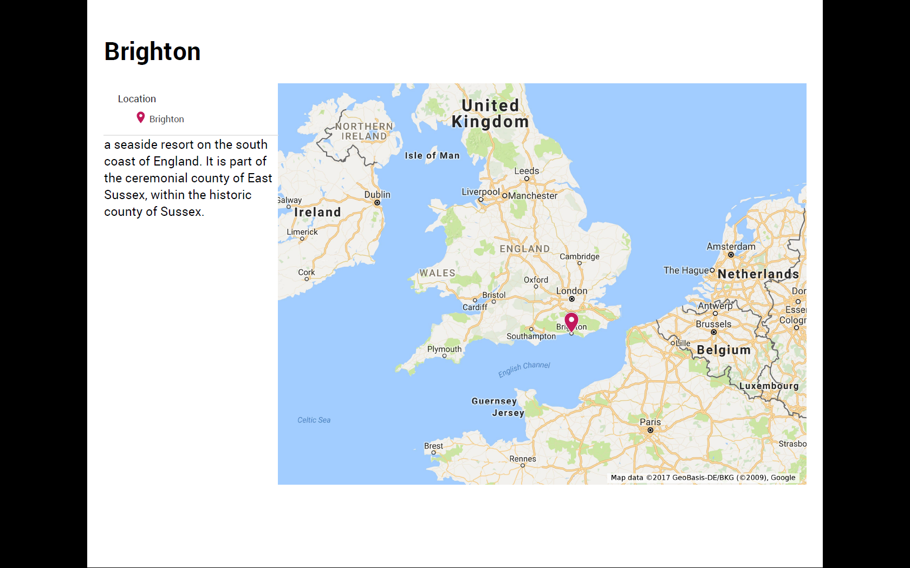

Slide 2
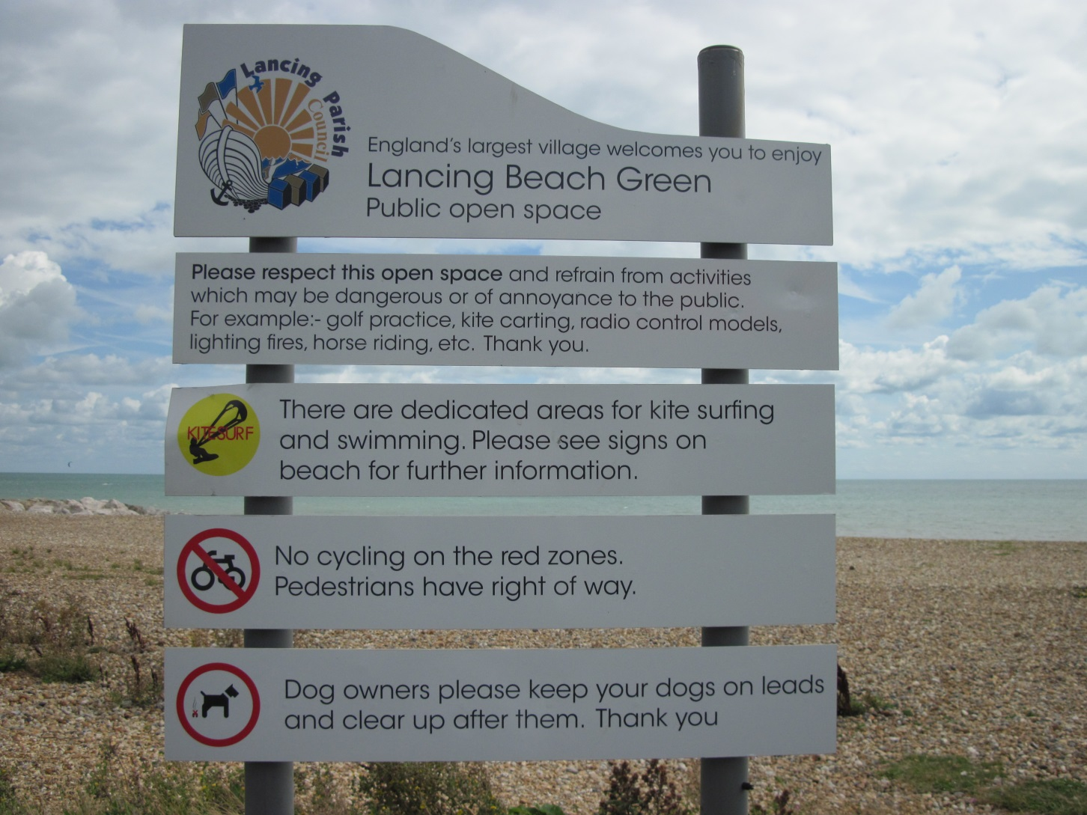

Slide 3
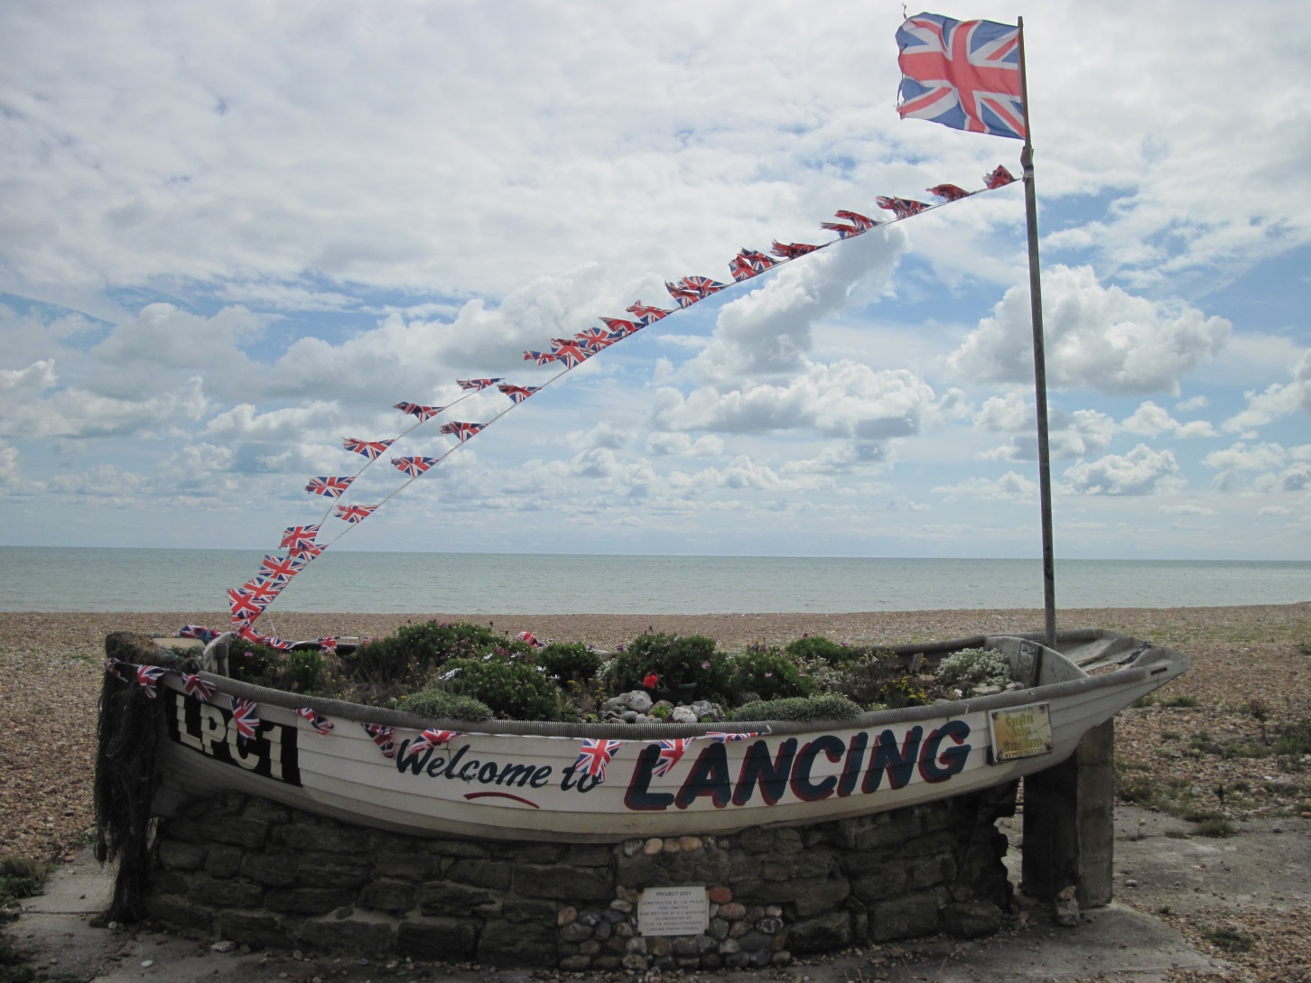
What was the weather like in the photo?
Typical weather in the UK is...

Slide 4
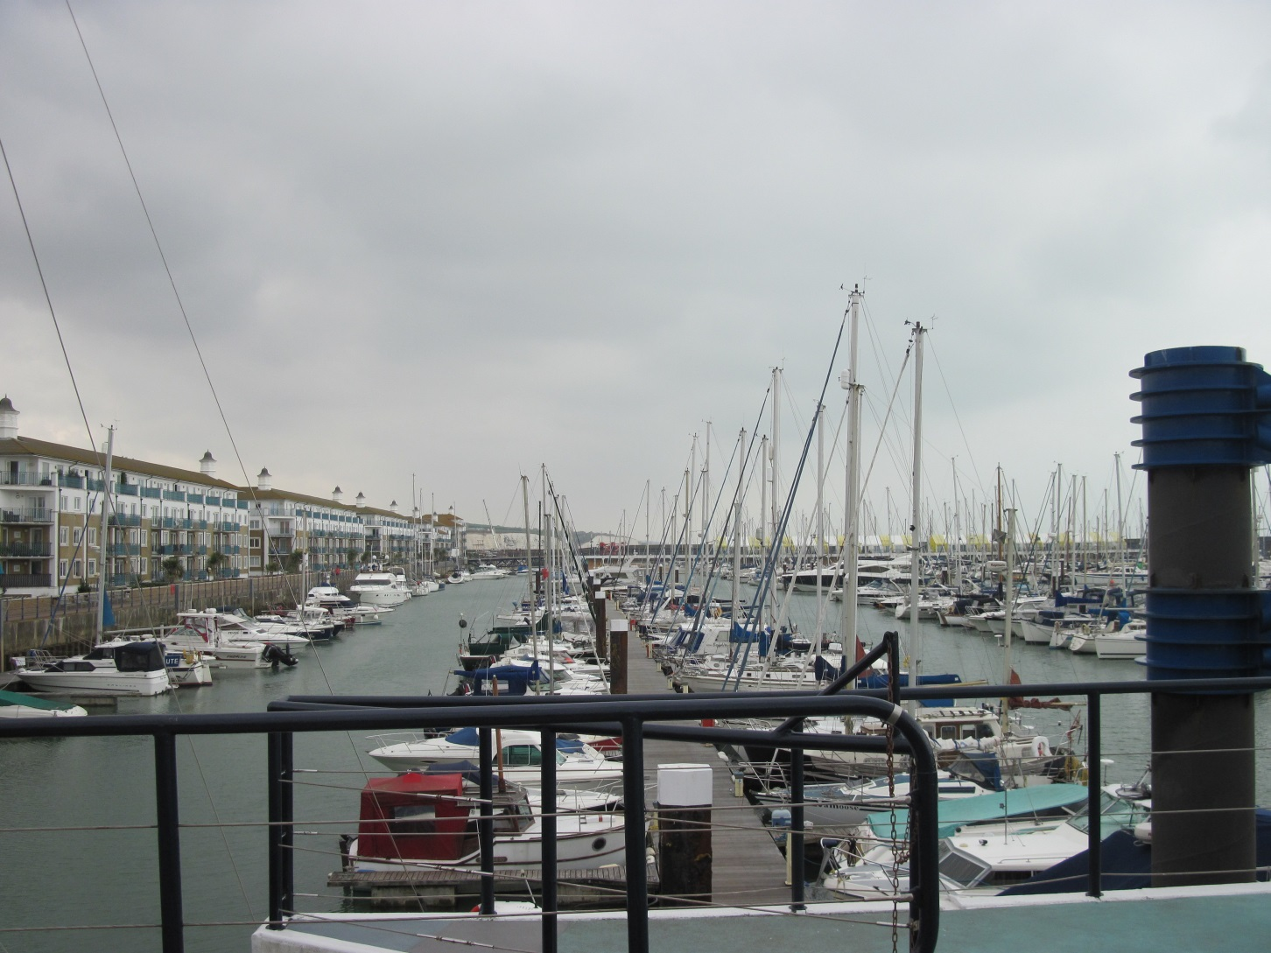
Brighton Marina

Slide 5
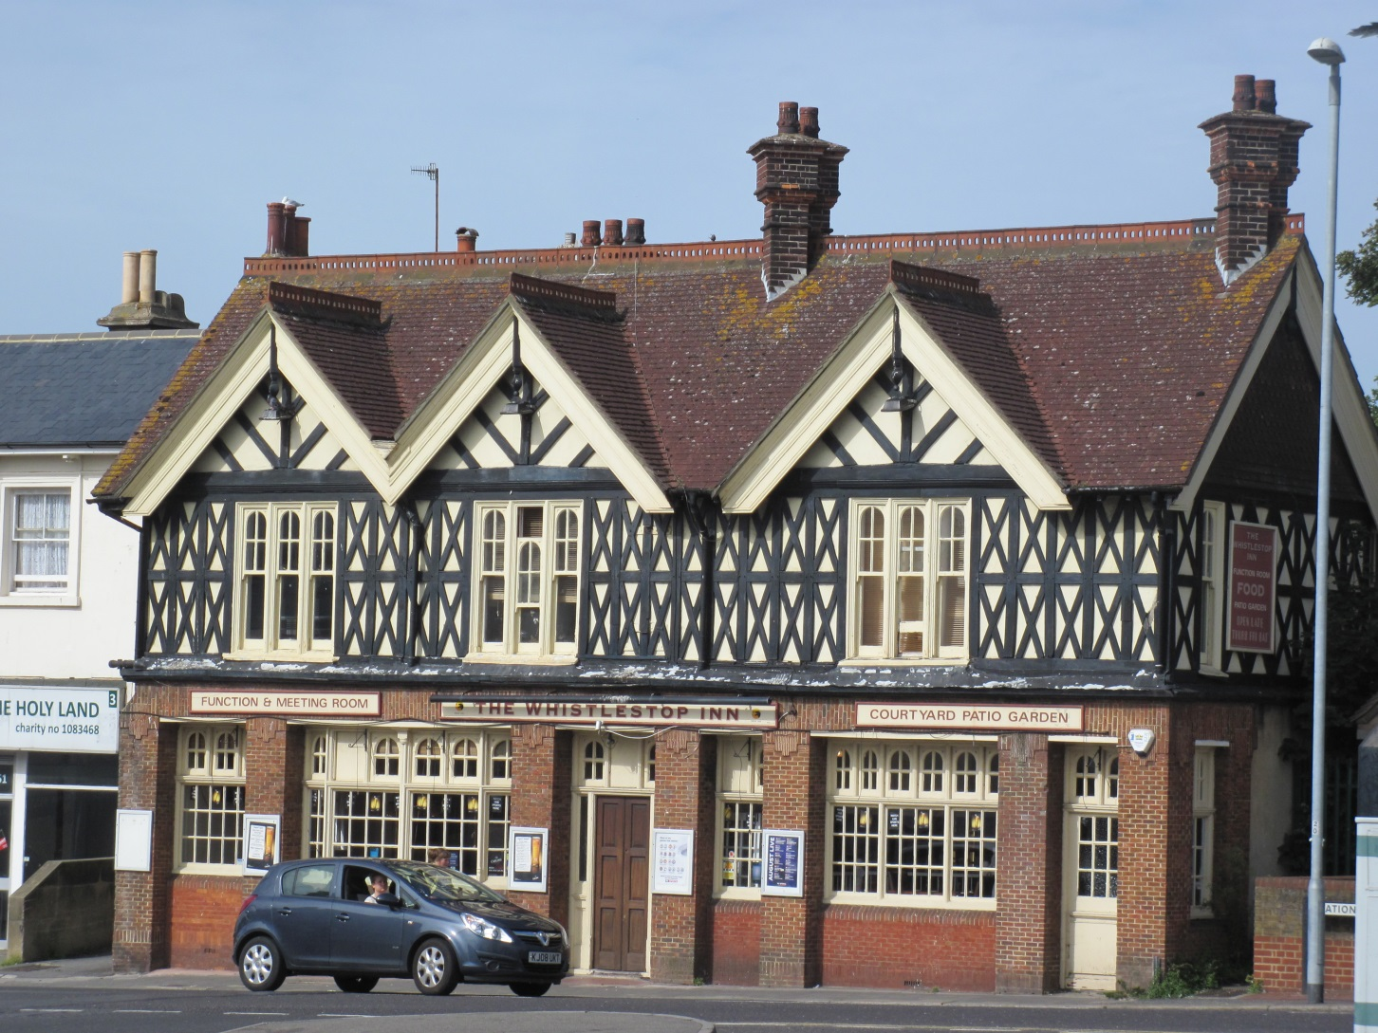
Most houses in England are made of stone or brick from the local area where the houses are built. The colours of the stones and bricks vary across the country and you can see a typical house of the southern England in the photo.

Slide 6
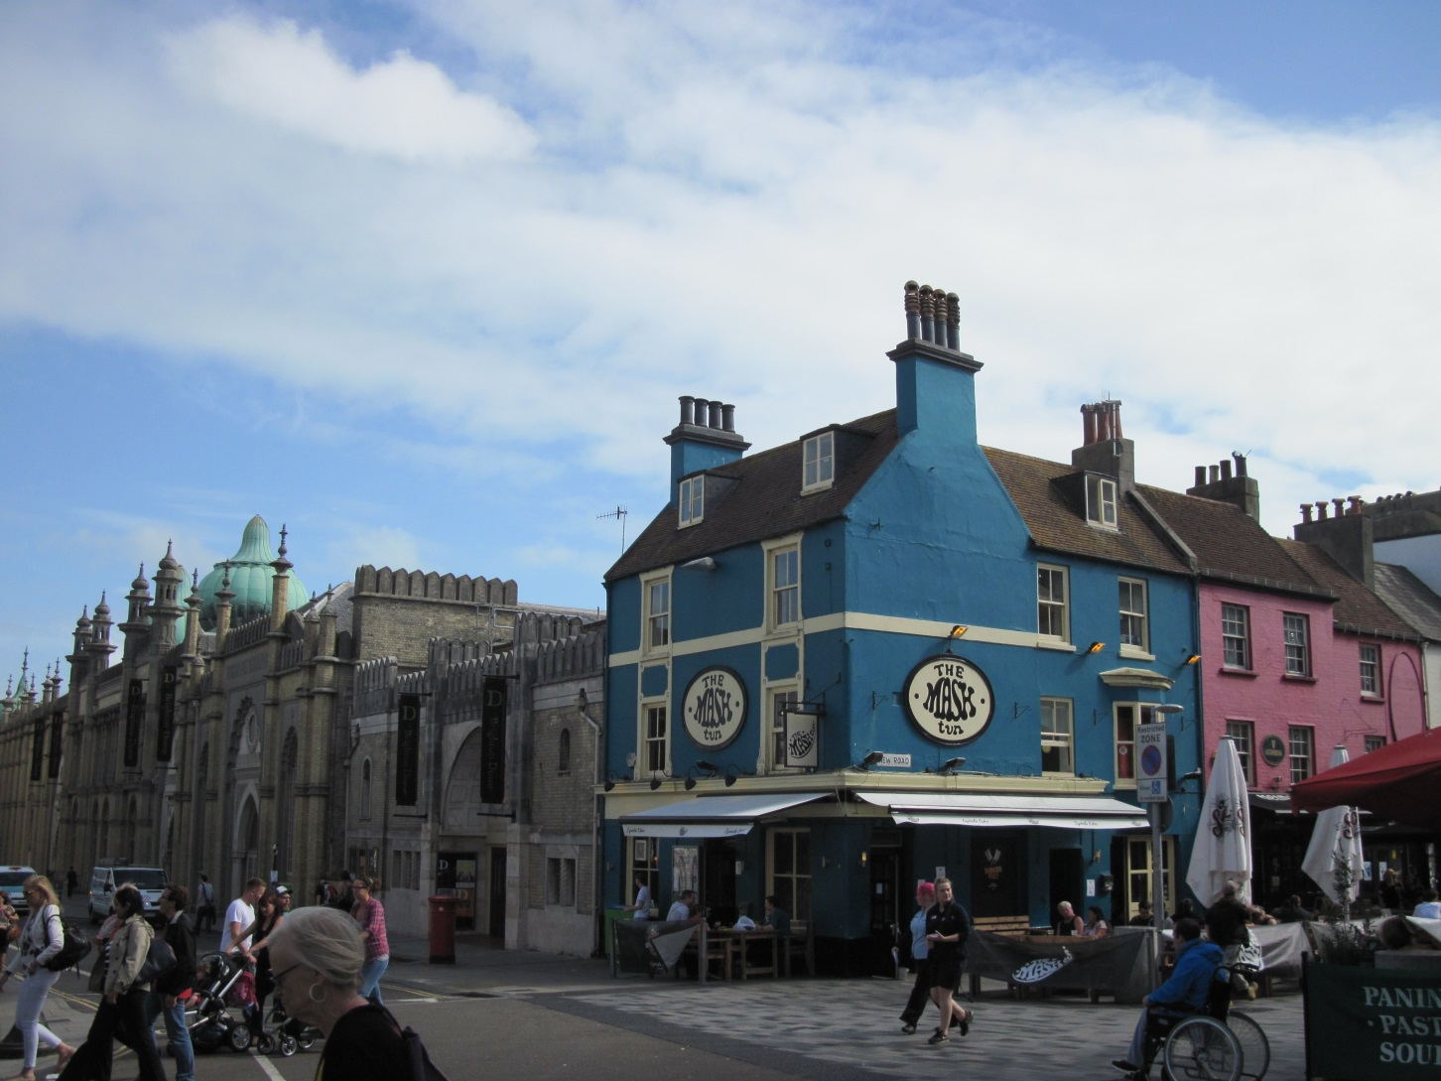
Modern colourful houses attached to the Royal Pavilion

Slide 7
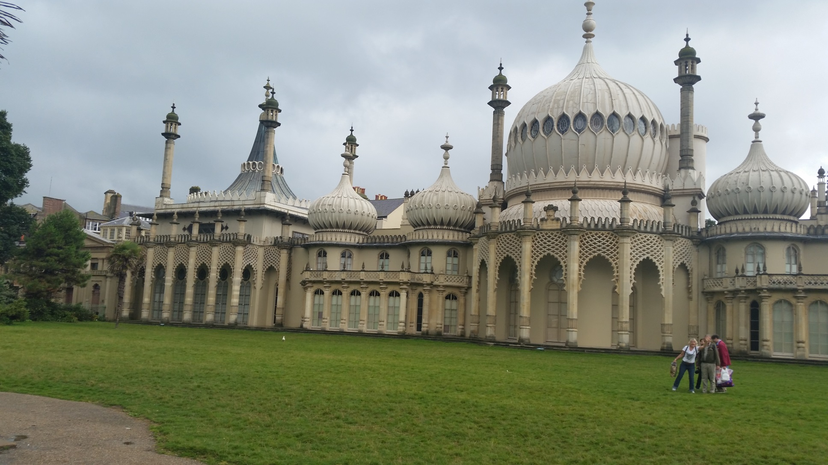
The Royal Pavilion was built for Prince Regent, the Prince of Wales, who later became King George IV, by designer John Nash between 1815 and 1822.

Slide 8
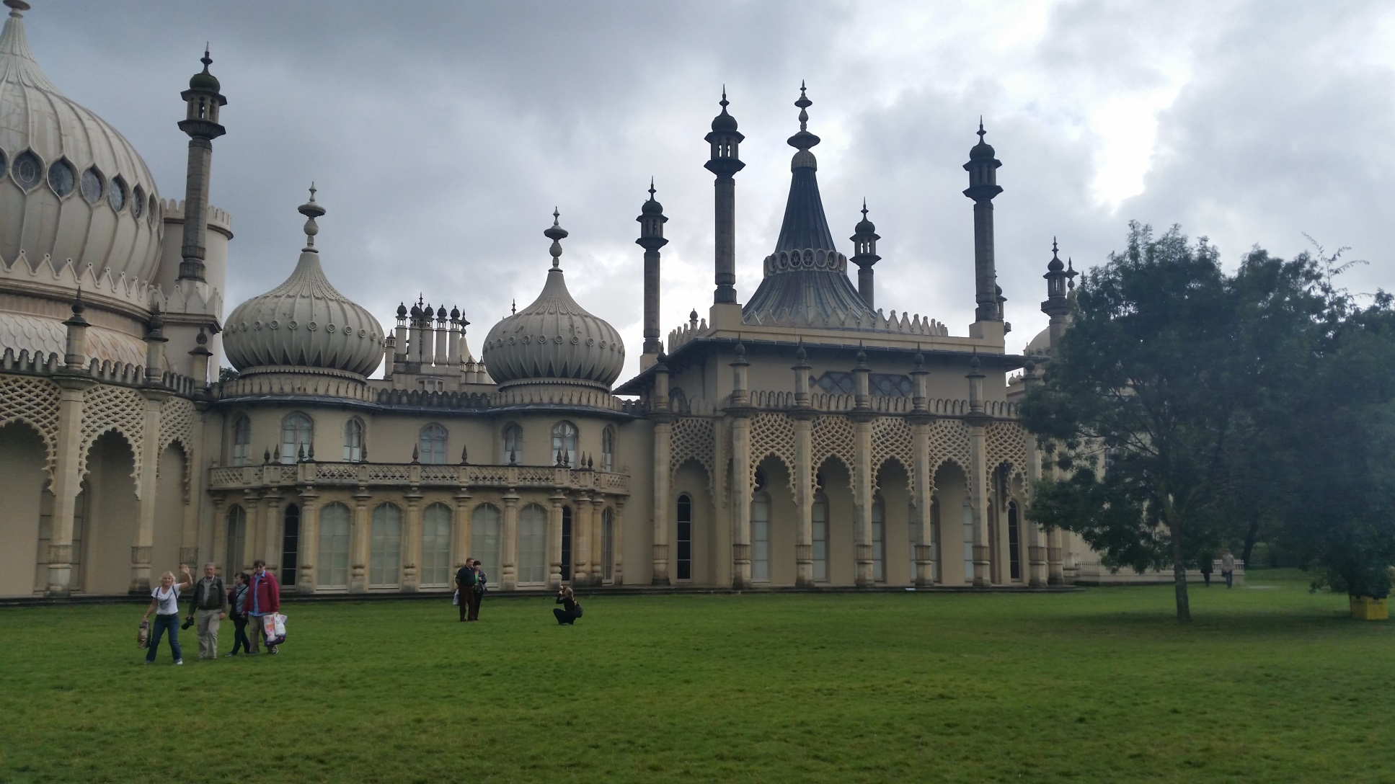
The Royal Pavilion is built in the Indo-Saracenic style dominant in India for most of the 19th century.

Slide 9
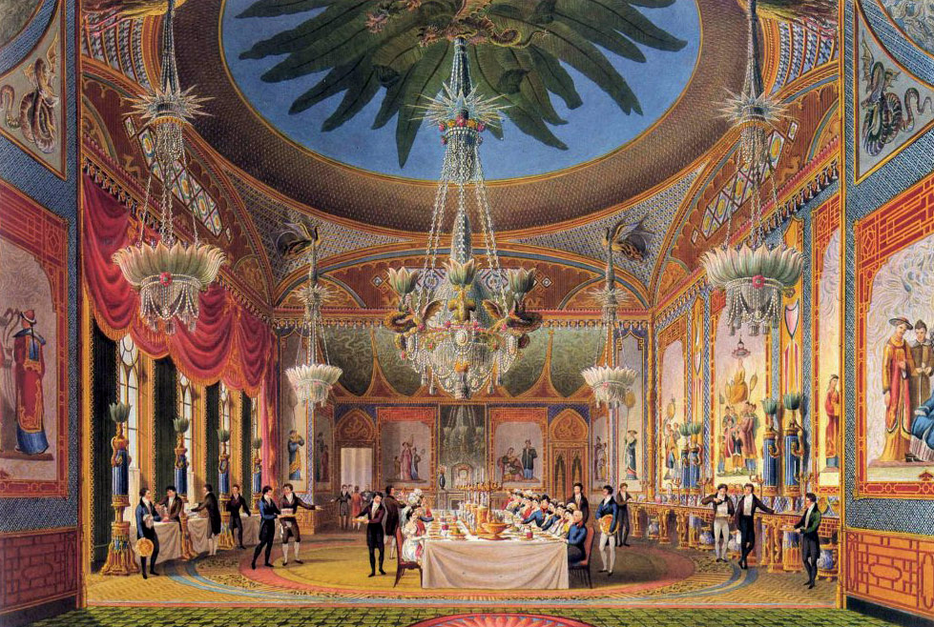
Banqueting Room and the fanciful interior design is heavily influenced by both Chinese and Indian fashion.

Slide 10
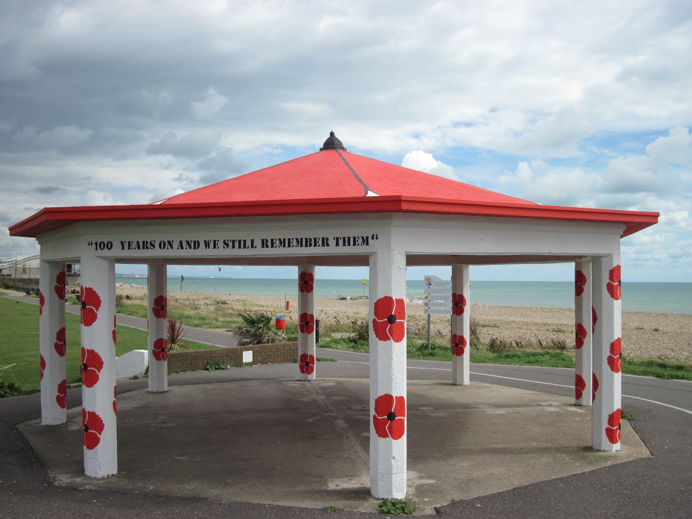
What symbolizes flowers of poppy in the UK?

Slide 11
Remembrance Day
(also known as Poppy Day or Armistice Day)
is a memorial day observed in Commonwealth countries since the end of World War I to remember the members of their armed forces who have died in the line of duty. Remembrance Day is observed on 11 November to recall the end of hostilities of World War I on that date in 1918.

